Slide 1
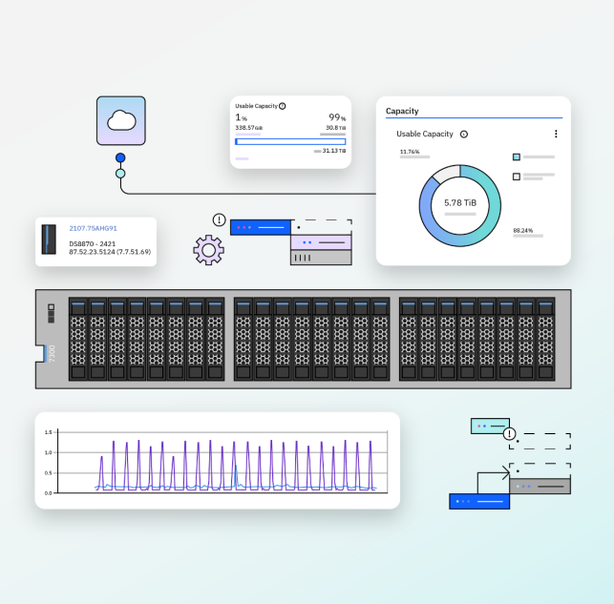
IBM Storage FlashSystem
Operationally Resilient
Primary Storage Platform
Notes:
Script:
Hi I’m [Speaker Name] and I am a [title] for IBM Storage. Today I’d like to spend time on how your primary storage can stay on top of operational resiliency with IBM Storage FlashSystem.
--
Speaker Notes:
Set the stage: You are a rep for IBM, introducing IBM Storage FlashSystem and operational resiliency
Audience: High level, executive that may know very little about storage and even IBM FlashSystem
Goal/Outcome: Based on your knowledge or context of the call, you want your audience to be engaged and ask questions throughout the slides and get them towards moving through the sales stages

Slide 2
Disclaimer
  The information in this document is IBM CONFIDENTIAL.
  This information is provided on an "AS IS" basis without warranty of any kind, express or implied, including, but not limited to, the implied warranties of merchantability and fitness for a particular purpose. Some jurisdictions do not allow disclaimers of express or implied warranties in certain transactions; therefore, this statement may not apply to you.
  This information is provided for information purposes only as a high-level overview of possible future products. PRODUCT SPECIFICATIONS, ANNOUNCE DATES, AND OTHER INFORMATION CONTAINED HEREIN ARE SUBJECT TO CHANGE AND WITHDRAWAL WITHOUT NOTICE.
  IBM's statements regarding its plans, directions, and intent are subject to change or withdrawal without notice at IBM's sole discretion. Information regarding potential future products is intended to outline our general product direction and it should not be relied on in making a purchasing decision. The information mentioned regarding potential future products is not a commitment, promise, or legal obligation to deliver any material, code, or functionality. The development, release, and timing of any future features or functionality described for our products remains at our sole discretion.
  IBM reserves the right to change product specifications and offerings at any time without notice. This publication could include technical inaccuracies or typographical errors. References herein to IBM products and services do not imply that IBM intends to make them available in all countries.
© 2024 International Business Machines Corporation | IBM Confidential
Notes:
Script:
Before we get into it, I’ll just need to indicate that this information we’re sharing today is considered confidential and any claims are subject to change.
--
Speaker Notes:
Sometimes, speakers will make this slide in a very light tone and approach to continue setting attendees at ease.

Slide 3



90% of organizations are engaged in an
enterprise-wide digital transformation
Agile infrastructure for application modernization
Unstructured data management for AI and analytics
Operational resiliency and governance of data
© 2024 International Business Machines Corporation | IBM Confidential
Notes:
Script:
Today, businesses are going through digital transformation, with hybrid cloud and AI driving that change. To keep up, customers are transforming their current infrastructure to address three key challenges. This is how we focus on what IBM can deliver to meet those challenges for our customers so they can focus on what matters most - their business.
First, app modernization requires agile solutions like Storage Fusion for automated, containerized deployment.
Second, unstructured data growth demands scalable storage like Storage Scale, and Ceph for AI and analytics.
But it's operational resiliency and the governance of data that's crucial. With rising cyber threats and data breaches, companies need secure, efficient, and modernized infrastructure. They are looking for ways they can secure their data and recover it with the most efficient and modernized approach. And that means really focusing on how they create operational resiliency in their organization today.
--
Speaker notes:
Top 3 points:
Customers facing transformational tech
Three key storage themes: app modernization, unstructured data, and security, resiliency, and governance of data
Focus in on last point
Longer script/takeaways:
App modernization: Customers find themselves wanting to accelerate their ability to build applications, leveraging both public cloud and their own on-premise infrastructure for deployment. They want to move away from manual to automated deployment, and so they’re looking for an agile solution that can support them on this journey.
Unstructured data: Number two, there is growth in the amount of structured and unstructured data, and on top of that, they’re trying to build applications that can leverage that data in real time.
Security, operational resiliency, and governance: Lastly number three , security continues to be a big challenge in data governance and resiliency. We all see the news every day on the increasing number of attacks on enterprises and the rising costs associated with data breaches and compromised platforms. On top of that, regulations are holding companies more accountable and actionable when it comes to the governance of data.
Companies are looking for ways they can secure their data and recover it if something happens with the most efficient and modernized approach to their infrastructure. And that means really focusing on how they create operational resiliency in their organization today.

Slide 4


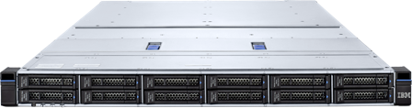
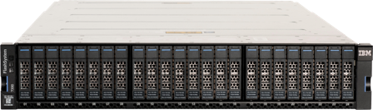
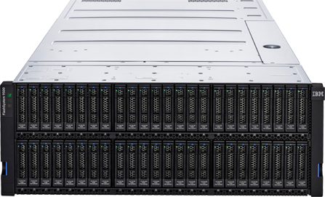
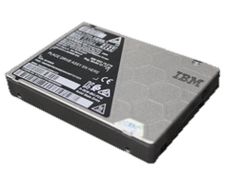
Executive summary
Drive operational resilience in your organization with a primary storage platform delivering data resiliency, efficiency and modernization.
IBM Storage FlashSystem
Primary storage platform leader for
operational resiliency
IBM Storage Insights
IBM Storage Virtualize
© 2024 International Business Machines Corporation | IBM Confidential
Notes:
Script:
From this presentation, I have two key takeaways. I’d like to make sure that you know how important it is to drive operational resiliency that can deliver on data resiliency, efficiency, and modernization. Second takeaway is IBM Storage FlashSystem is the all flash primary storage platform leader that can provide operational resilience for your primary data storage today.
Let's dive into operational resilience first.
--
Speaker Notes:
Key point: Two key takeaways for today's session

Slide 5
Storage operational resilience is the ability to maintain data access, services, and performance despite any potential disruptive scenario.
It involves the creation of a storage platform that efficiently delivers data resilience while leveraging the intelligent modernization available in today’s quickly changing world.
$4.45 million
The global average cost of a data breach in 2023 was USD 4.45 million, a 15% increase over 3 years.
1.7 terabytes in 1 minute
If you discover an attack in less than one minute, only 1.7 TB of data are impacted, but after 24 hours, it is over 2.5 PB.
Sources: https://www.ibm.com/reports/data-breach
© 2024 International Business Machines Corporation | IBM Confidential
Notes:
Script:
When it comes to storage, we define operational resilience as the ability to maintain your data access, services, and performance through any potential disruption, whether that is a cyberattack or a natural disaster. And disruptions matter – [CLICK]
According to the 2023 Cost of a Data Breach report, the average cost of a data breach in $4.45 million dollars, and that has increased by 15% over the past 3 years.
And if you take a look at the recovery side of it, detecting fast and recovering fast are crucial. For example, if you discover an attack in less than one minute, only 1.7 TB of data are impacted, and this is where attackers are usually starting their ransom negotiations with companies. After 24 hours, it is over 2.5PB that you will have to recover and try to get back for your business.
So there is a great urgency to give your storage admin a way to save the day and reduce costs by driving efficiency, data resiliency, and modernization into your storage platform. And that is where IBM Storage FlashSystem can help you today.
--
Speaker notes:
Top points:
Define storage operational resilience
Why should you (the client) care about operational resiliency?

Slide 6


Driving operational resilience in your organization with
IBM FlashSystem
Primary Storage Platform
Data Resilience
Strengthen and simplify your data defenses, threat detection, and recovery capabilities of your critical data
Efficiency
Reduce energy costs and consumption with our optimized architecture while optimizing storage asset utilization
Modernization
Optimize your storage management with the latest approaches to intelligently automate your hybrid cloud platforms
© 2024 International Business Machines Corporation | IBM Confidential
Notes:
Script:
Let’s dive into those 3 themes to drive operational resilience for your storage platform.
Data resilience: Data resiliency is when you feel confident your storage can manage business continuity from any type of disruption that will inevitably happen, like a cyberattack or a natural disaster. By strengthening your data defenses with protection, detection and recovery capabilities, your storage platform is able to stay at peak performance even through these events.
Efficiency: Simplicity is key to efficiency, especially when it comes to your architecture, technology, and operations. You should be able to scale up your performance with enterprise storage virtualization and have the computational storage and offloading capabilities that optimize your storage asset utilization, effectively reducing your overall costs and energy consumption.
Modernization: Last but not least, modernization. Modernization can mean many things, but for storage it means your platform is capable of handling integrations easily across your technology stack and is AI enabled at every level. It also means that you are planning your storage platform strategy that will fit your business needs today, but is flexible enough to accommodate any future needs and system upgrades.
--
Speaker Notes:
Top points:
IBM FlashSystem drives operational resilience at its core
For this presentation, we will dive into our three pillars for operational resilience: data resiliency, efficiency, and modernization
Data resilience: protection, detection and recovery from disruption with confidence on business continuity
Efficiency: simplicity and savings is key; energy consumption speaks to sustainability
Modernization: AI enabled at every level of the platform, integration with your tech ecosystem, and flexible consumption available with the latest in infrastructure technology
Discussion question: So before we get any further, which one of these pillars is most important to you and your business? Why?
Don’t worry about going over here when asking about questions, discussion is good, remember your goal to get them into the sales stages
If yes: super
If not: great points I'm going to take back to my team and come back with answer on how to address those

Slide 7
IBM FlashSystem
© 2024 International Business Machines Corporation | IBM Confidential
Notes:
Script:
Now let’s take a look at IBM FlashSystem.
Speaker Notes:
If a good discussion is happening around the pillars, think about how you can emphasize different next level details to keep them engaged and thinking about their next steps. The audience may want to engage in discussion or just listen comprehensively, so better to check in on the transitions between sections.

Slide 8
IBM Storage FlashSystem
Primary Storage Platform
Storage Lifecycle Platform with integrated analytics and AI enabling “cloud-like” operations
Common software platform delivering Enterprise Data Services for hybrid-cloud environments
IBM Storage Insights
IBM Storage Virtualize
FCM AI-enabled computational storage for efficient data processing and ransomware threat detection
FlashSystem’s family of systems meet customer needs for every capacity, performance point and operating environment
Data Resilient
Efficiency
Modernization
Protect, detect and recover from cyberattacks and outages
Drive down data storage costs in the data center
Modern management and consumption models
© 2024 International Business Machines Corporation | IBM Confidential
Notes:
Script:
Let’s walk through our components for our primary storage platform. Sitting on top and embedded into our FlashSystem are IBM Storage Virtualize and IBM Storage Insights. IBM Storage Virtualize adds a common operating environment across our primary storage platform and capabilities across those three pillars – data resiliency, efficiency and modernization.
And at the core of our platform is IBM FlashCore Modules, an industry leading computational offload storage module.
FlashCore Modules consistently deliver very low latency and includes hardware-based, wire-speed compression that delivers with no impact on performance.
Looking at the building blocks with our FlashSystem family of storage options, they provide what you need in terms of capacity, performance, and operating environment with standardized components. We have models that can scale up or down with you as your business needs change so it can fit entry level and enterprise level needs.
And included with every storage solution to help optimize your management using AI capabilities is IBM Storage Insights. This is our AI-powered predictive analytics and proactive monitoring solution for your primary storage platform.
All of these components bring together our three pillars –data resiliency, efficiency, and modernization – all within one platform.
In the next slides, I’ll go into more detail about our FCMs, storage options for FlashSystem, and the software that brings it all together.
--
Speaker Notes:
Top points:
How the three pillars come together for the full flash platform strategy
Walk through counter clockwise

Slide 9
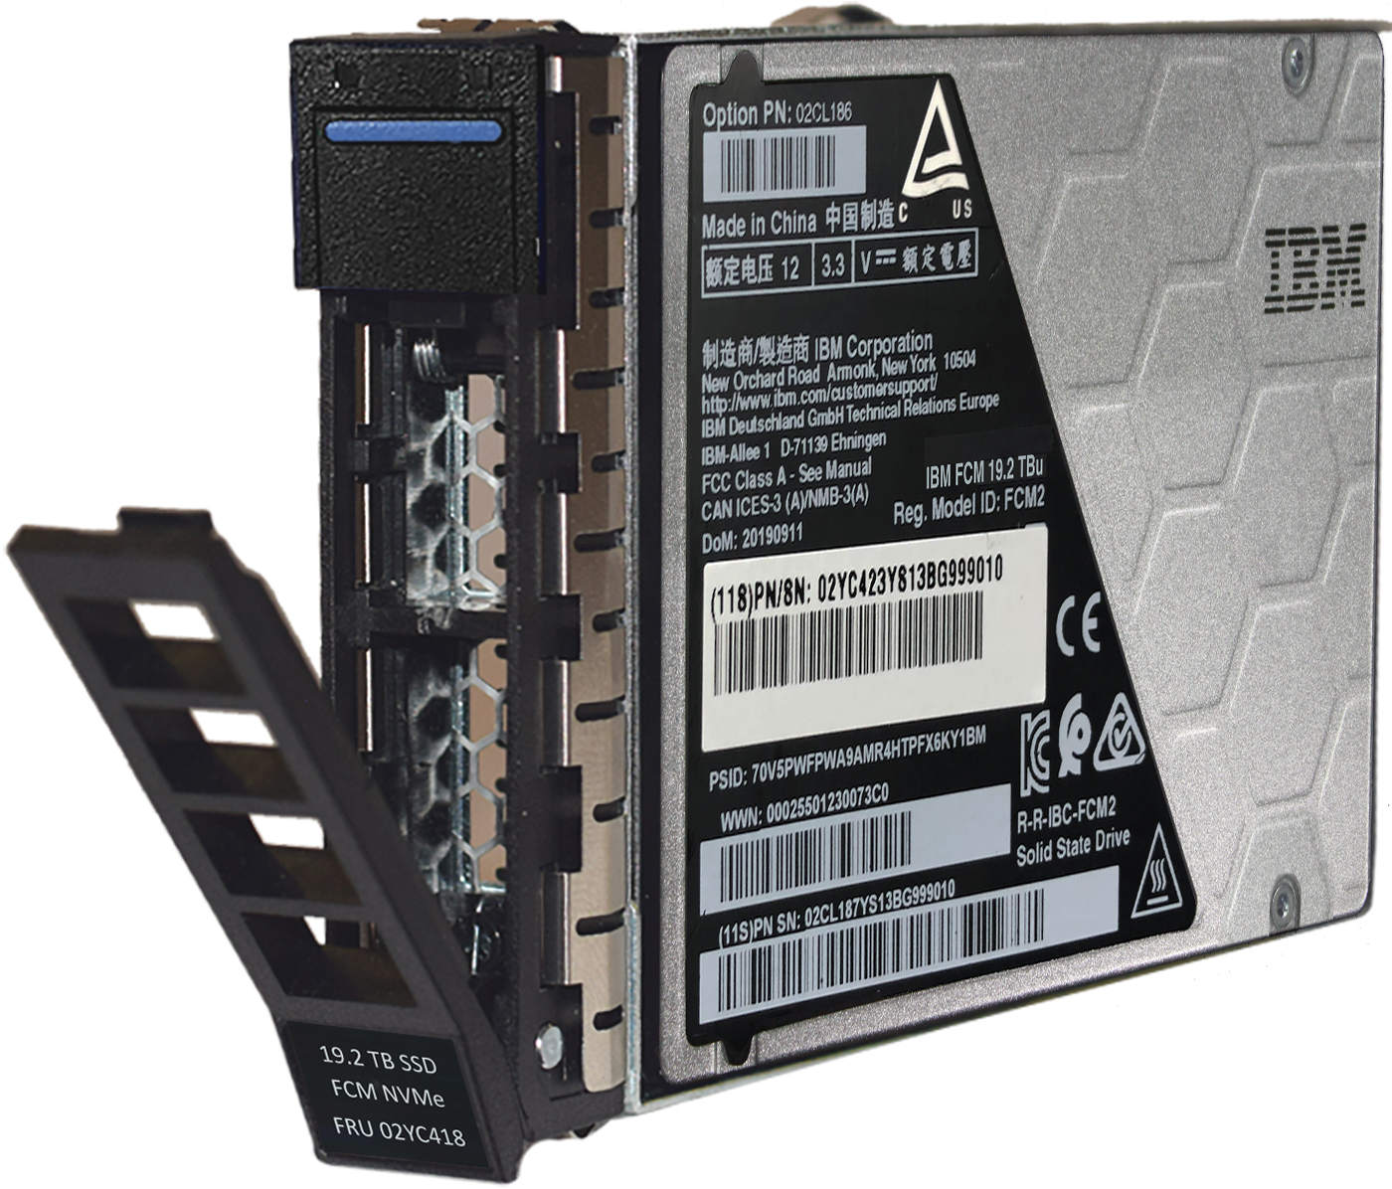
IBM FlashSystem powered by IBM FlashCore Modules
Industry-leading computational storage offload
IBM’s FlashCore Module Generation 4 computational storage offload modules deliver industry leading performance, market leading density, and Ransomware Threat Detection, with mission-critical reliability.
What value does it bring QLC technology density with enterprise availability and performance I/O level Ransomware Threat Detection with no performance impact Compression with no performance impact Encryption with no performance impact
Why does that matter Preserves flash storage life, while increasing performance & device longevity Sustainable: more data with vastly reduces power, cooling and floor space Supports optimization of enterprise workloads Detect potential threats at the I/O layer – “Last Line of Defense”
© 2024 International Business Machines Corporation | IBM Confidential
Notes:
Script:
So, let’s talk a little bit about FlashCore Modules. They are IBM’s computational storage offload module that delivers great operational and efficient performance with its flash density, drive endurance, and reliability. It also has capabilities like ransomware threat detection at the IO level that will sync up with Storage Insights so you can monitor and be alerted for any anomaly detections in your block storage.
What makes this module stand apart is that it brings efficiency with modernization to your storage platform and critical workloads, while also now providing a new security line of defense when you’re writing data on your drive.
So, this is a really exciting storage module to have in your primary storage platform because its unique value with efficiency and security capabilities, but no performance impact is what makes it so industry leading within the market today.
--
Speaker Notes:
Top 3 points:
Showcase FCM as the industry leading offload module
Value it brings to your storage platform
Why it matters: efficiency with modernization
This storage media provides extraordinary density with the large 38.4TB being the highest capacity flash drive available in the market, while still achieving latency as low as 50 microseconds. “There is a 61TB NVMe drive out there now, so this needs to be change to “Highest dual ported NVMe drive on the market.” And no one has built in compression allowing them to store up to 115TB after compression.

Slide 10



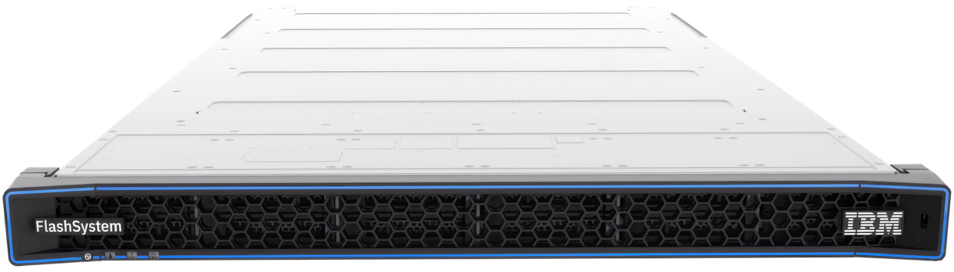


FlashSystem Family
Primary Storage Platform
NEW
FlashSystem 5015 & 5045
SAS based entry to the world of IBM Storage Virtualize and FlashSystem.
FlashSystem 5300
Next-gen of Award-winning efficiency leader. Densest 1U system unlocks the FCM value proposition to everyone
FlashSystem 7300
The 5th generation of the award winning 7000 series, striking the right performance, scaling and value balance
FlashSystem 9500
Extreme performance for large, mixed and consolidated workloads
400k* IOPs, over 28GB/s and 1PB effective** per controller. Up to a 45% increase IOPs and 50% increase bandwidth vs 5200 controller.
530k* IOPs, over 45GB/s and 2.1PB effective** per controller.
1.4M* IOPs, over 100GB/s and 4.4PB effective** per controller.
Powered by IBM Storage Virtualize
Storage Virtualize for Public Cloud
Hybrid Cloud integration with FlashSystem products allows seamless data migration from on premise to your chosen cloud provider.
SAN Volume Controller (SVC)
Celebrating 20 years in market, SVC supports more than 500 models of storage controller with seamless SVC and storage replacement.
IBM FlashCore Modules
The 4th generation of one of FlashSystem key value propositions with:
AI-enabled Ransomware Threat Detection
Data Reduction HW-offload
Densest Tier-0 flash drive
IOPs quoted are real life 16KB blocks with a 70/30 R/W ratio (from media!)
** Based on 3:1 ratio compression
Notes:
Script:
Now let’s take a look at the FlashSystem family of storage options. You have your entry base option with the 5015 and 5045 on one end and those are great for remote offices and secondary workloads, so these are you cheap and deep options. On the other end you have the 9500 that offers your extreme performance and scalability for your enterprise data storage. The 7300 sitting in between as the sweet-spot for mid-sized enterprises and workloads.
In May 2024, we released the 5300. This is an evolution of our award winning 5200 and is at the forefront in providing an entry storage option that has substantial efficiency, data resiliency and modernization at its core. It has been very exciting to introduce this to our customers and we are continuing our innovation momentum with this model by incorporating our new FCM with IO level RTD, as well as a performance boost in compression.
In addition, we have other platforms that support additional types of workloads; for example, public cloud and SAN volume controller.
Now that I’ve gone over a few of the storage options, let’s dive a little more into Storage Virtualize that is on cloud and on prem and Storage insights in the next slides that is available on our FlashSystem storage family.
--
Speaker notes:
Top 3 points:
Diving into FlashSystem platform family with storage virtualize and storage insights
Focus on 5300 new announcement
Technical notes:
We released the 5300 in May. An evolution of the award-winning 5200 and a substantial performance boost, bringing one of the key value propositions down the entry space with FlashCore Modules on their fourth generation, offering AI-enabled Ransomware Threat Detection in seconds, scanning every I/O, data reduction HW-offload which is one of the key-reasons why our products offer leading cost-performance ratio. A key point to make with FCMs is that they’re still the densest Tier-0 flash drive, while others have released denser drives, they’re pure QLC drives, which don’t perform nearly as good as FCMs, or TLC drives.
It has the latest generation of FCM that provide the IO level ransomware threat detection as well as a performance boost in data reduction.
This creates a 45% increase in IOPs performance and a 50% increase in bandwidth vs the 5200 controller.
To deliver the highest level of performance along with the ability to provide external storage virtualization, our clients will require Non-Volatile Memory express (NVMe) based solutions. Although these arrays can use industry standard NVMe solid-state drives (SSDs), it is anticipated that most clients will opt for IBM FlashCore modules (FCMs) which possess significant differentiation and competitive advantages. FlashSystem 5200, 7300, 9500 and 9500R are truly future proofed. They support essentially all drive types, including storage class memory (SCM), in order to optimize a client’s data economics. Up to 12 SCM drives can be placed in any IBM FlashSystem solution that supports NVMe.

Slide 11




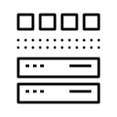






Storage access made easy with IBM Storage Virtualize
Common software platform delivering enterprise data services across FlashSystem family
Data Resilience
Data recovery
Secure access
Drive encryption
Data recovery
Efficiency
Storage virtualization
Policy based replication
Data reduction
Partition mobility with Flash Grid
Modernization
Ecosystem integration
Automation with Ansible
AI and ML integrations
*Not all features are available on 5015 / 5045. Please see website for more information. IBM.com/flashsystem
© 2024 International Business Machines Corporation | IBM Confidential
Notes:
Script:
Storage Virtualize is storage access made easy: it adds a common operating environment for all integrated arrays on the FlashSystem family. This common software platform creates easy access and better workflows for your storage admins to get the most out of their storage environment.
In one view, you can use capabilities we have discussed like data recovery, data reduction, partition mobility, automation, and secure access. And it is available on premise or in the public cloud.
This is a really great component of our FlashSystem family that creates less silos and an easier integration into your full technology stack from your primary storage platform.
--
Speaker notes:
Top points:
Ease of access creates better workflows to fully utilize assets and their capabilities in 3 pillars
Ease of deployment on premise or on cloud, also with integrations
Discussion question, post read-out: what are some features you are using today when it comes to data resiliency? Or efficiency?
These are the hot topics in the market:
VMware integration - re: vVols
defender/cohesity
IO level ransonware
3-site
2-active active
flash grid - pull it out specifically

Slide 12




IBM Storage Insights: the Storage Admin Assistant
Increase your productivity with intelligent optimization of your infrastructure
I want to have confidence that my storage is secure
Ransomware Alerting
Anomaly Detection
I want an AI assistant that helps me manage the complexities of my hybrid cloud storage
Proactive Ticket Resolution
Capacity Forecasting
I want to optimize my storage assets to deliver on business service levels
Infrastructure Optimization
Platform integrations w/ REST API
I want proactive help to avoid service disruption, and trust that problem resolution is handled quickly
Future Conversational AI Interface
© 2024 International Business Machines Corporation | IBM Confidential
Notes:
Script:
Now we will talk a little bit about Storage Insights. This is our AI powered software for monitoring performance as well as analytics and alerts. I have mentioned it a few times already, at how it works with our RTD with FCM but what I haven’t mentioned is how much it will optimize the time your storage admin has for their day to day, so think of it as a Storage Admin Assistant in that respect. There’s a few use cases featured here, that range from feeling confident that your storage is secure and that you can forecast and manage your capacity with ease. Not only that, but we are also envisioning that we will expand its AI powered capabilities that exist today for ML and bring in a conversational AI interface, so we’re building more and more AI into our storage platform to bring more efficiency and modernization all in one go.
--
Speaker notes:
Top 3 points:
Describe Storage Insights with the analogy ‘The Storage Admin Assistant’
Slow down a little here and spend some time discussing the AI benefit
Good to know points that come up as questions:
When will you have GenAI capabilities? We are looking to have by end of year
Is this available on premise? No, it is not available today, but tell me more about your need.
<!—older speaker notes--!>
Watson assistant NLP modules. We will need to extend to use watsonx.ai for more free flow conversational interaction (Intent Classification/Entity Extraction - leverage LLM modules like flan-ul2 with prompt engineering and RAG-Retrieval Augmented Generation)
Co-relation analytics based on FCM compression and write entropy per volume
Analytics leveraging forecasting of SLA (IOPS, Response Time, Capacity) at volume level and determining the best candidature via constraint driven optimization and Best Fit method
Forecasting capacity at storage and volume level –Prophet, LR, ARIMA
Anomaly detection by employing key storage metrics (KPIs) for real-time analysis, leveraging AI language models - LSTM-based autoencoder AI algorithm.
Harnesses the power of AI algorithms to analyse historical support tickets and intelligently suggest potential solutions for new and complex issues – BERT & FAISS (Facebook AI Semantic Similarity)

Slide 13
New in 2024
© 2024 International Business Machines Corporation | IBM Confidential
Notes:
Script: So, I have talked a little bit about what we are planning to do with Storage Insights but let me showcase a couple more things we launched in 2024.
-OR-
So let’s take a look at what’s new in 2024.

Slide 14


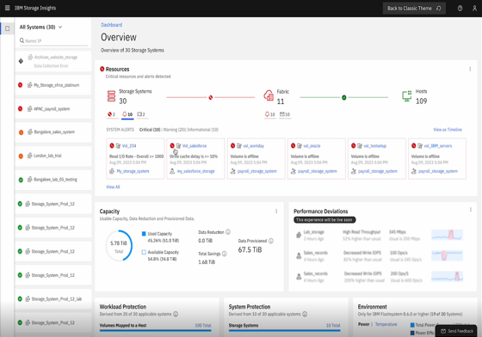
IBM Flash Grid with Storage Insights
Partition mobility
Flash Grid
Flexible & scalable federated architecture
Dev Test
Independent system and failure domains
Production
Optimize applications with HA / DR
HA
Non-Disruptive Partition Mobility
DR
Single pane of glass management
Intelligent placement with AIOps
Partition
2Q24
Partition Mobility – initial focus on migration cases
Workload placement based on device utilisation and capacity prediction
2H24
Use AI to ensure each device is running within optimal limits, recommending partition mobility to balance load across available resources
Host
Connectivity
Primary Data
Backups
HA & DR
Management
SLAs
© 2024 International Business Machines Corporation | IBM Confidential
Notes:
Script:
We made a few new announcements in Q2, starting with Flash Grid and then I’ll cover Storage Assurance. These have been important to our approach with modernization.
Flash Grid is an important new concept of federated architecture. It introduces a new flexible, scalable way to balance workloads across the Storage Virtualize devices in your estate, allowing you to non-disruptively move workloads or these partitions around different systems to maximise your asset utilization. This means you can move not only your data, but all of the data storage components already customized for that partition. This creates less issues that can happen around data migration and moves it toward being a regular operational standard as opposed to a special project activity the requires time, effort and potentially additional costs. With Flash Grid, you can move partitions in a short amount of time with very little post migration follow up.
We just announced non-disruptive partition mobility in Q2 and then intelligent placement using AIOps in the second half of 2024.
With this introduction of Flash Grid, IBM FlashSystem are simplifying the complexities of managing storage environments with the introduction of partition migration capabilities to ultimately deliver non-disruptive operations across your storage environment.
--
Speaker Notes:
Top 3 points:
What did we launch this year? Focus on this and storage assurance [next slide]
What’s new with Storage Virtualize with Storage Insights: introducing partitions
Need to understand technical concept, virtualize is key on how to move, insights tells you how best to
federated is key; take one out and it won't destroy anything, workload keeps running
get their agreement for tech experts chat for cool technology (goal)
IBM is bringing industry leading data resilience and cyber security capabilities to this segment of the marketplace by extending our DR/BC/HA capabilities with new Storage Virtualize replication capabilities.
With the introduction of Flash Grid, IBM FlashSystems are simplifying the complexities of managing storage environments with the introduction of data migration capabilities to ultimately deliver non-disruptive operations across your Storage environment.
Flash Grid introduces a new flexible, scalable way to balance workloads across the Storage Virtualize devices in your estate, allowing you to non-disruptively move workloads (partitions) around to maximise asset utilisation and business needs.
With the introduction of IBM’s unique FCM4 and new Ransomware threat detection IBM ensures customers are further protected from new cyber security threats through faster detection and recovery capabilities.
And later this year, 3-site DR will be introduced to provide even greater levels of DR/HA/BC capabilities, all at a unmatched level of business efficiency for the marketplace.

Slide 15









Purchase IT for Life with IBM Storage Assurance Perpetual
Never again experience…
Forklift upgrades with disruptive data migrations
Franken-systems with pseudo-modern individual controller replacements
Steep price increases as your current device ages
Rest Assured with a…
Subscription to innovation with full-system HW & SW upgrades delivered as needed
Guaranteed performance, energy efficiency and non-disruptive migrations
Premium highest level of maintenance that proactively supports at a flat rate
Ultimately achieving…
Perpetual Non-Disruptive Modernization
A set and forget storage lifecycle experience with a lower TCO
Less risk and more results for your business
© 2024 International Business Machines Corporation | IBM Confidential
Notes:
Script:
Also announced in Q2, IBM Storage Assurance is a new perpetual consumption model for IBM FlashSystem. This innovative offering lets you 'buy IT for life' with flat, regular, and transparent pricing. With Storage Assurance, you will get full system upgrades, guaranteed performance, and proactive support, ensuring your primary storage stays modern.
Remain confident that you will never again experience disruptive migrations, stitched together franken-systems, and steep price changes. This 'set and forget' lifecycle management system reduces overall TCO and increases the lifetime value of your storage. With data center costs rising, Storage Assurance provides the best value and technology for getting the most out of your storage platform over the years.
--
Speaker Notes:
Top 3 points:
New consumption model assuring your primary storage
Ultimately delivers modernization, lower TCO and less risk/more results for your business
Never experience (or never again) painpoints with your primary storage platform
Longer script/takeaways for Storage Assurance:
We plan to do this with IBM Storage Assurance on our FlashSystem storage devices. This is an offering that allows clients to buy IT for life, staying modern forever with flat, regular and transparent pricing. This allows clients to mitigate their financial and operational risks with more of the ownership being on IBM as a vendor of the storage.
The first assurance that we provide is automatic hardware refreshes around SLAs when needed throughout the lifecycle. This could be for a variety of reasons: 1. When we were looking at designing this offering, we noticed that competitors in the market do controller refreshes for performance upgrades overtime. When we looked in our install base, we noticed that the overwhelming majority of our clients barely utilize the CPUs on their systems because we have computational storage and an active-active architecture so our performance scales efficiently with our capacity. Given this, if we provided new controllers only, clients wouldn’t always see performance improvements because we do CPU intensive tasks on the drives (i.e. compression, garbage collection, etc.). Also, we know that our clients would desire media refreshes overtime because we don’t just provide density improvements on those, but we also provide unique innovation down to the drive hardware level overtime. So we designed to our strengths and our platforms – if performance upgrades are needed after year 3, we will provide them with a performance upgrade. But more importantly, if clients ever face the pain point of being put on terminal SW, end of support or not being able to upgrade their hardware through MESes, we will provide them with a full system refresh in the same generation with same or better capacity and same or better performance.
The second key value that is delivered through this program is that it is a higher-level experience with more of the risk being on IBM and less on the client. Included in this program is the same amazing premium-level ExpertCare maintenance SLAs that we have today as well as a new non-disruptive system to system migration guarantee for when clients trigger a refresh with our new FlashGrid migration technology that we are releasing. Finally, clients can rest assured in the amount of energy they can expect to use with our energy efficiency guarantee.
Let’s talk about the contract length, pricing and flexibility of this Storage Assurance offering. Clients purchase new FlashSystem hardware and then in place of ExpertCare, they sign up for either a 4-year or 8-year Storage Assurance contract that includes all of the above at a flat rate guaranteed. This includes all of the software needed to run and track the FlashSystem devices like Storage Insights Pro and Storage Virtualize. They can pay for this contract either upfront, annually, quarterly or monthly – whatever they prefer. But these contracts are also extremely flexible. If they ever wanted to upgrade to the latest generation even with an SLA isn’t triggered or move from one system to another (i.e. FS5k -> FS7k), then they have a right to do that at any point in the contract with trade-in credit included.

Slide 16
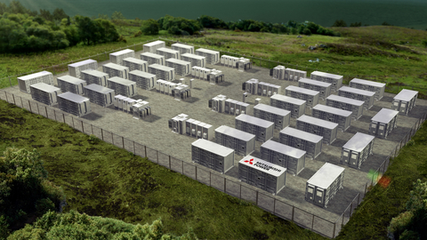
IBM FlashSystem Flash Grid Capabilities Journey
 | Operational Resilience | What’s next | Vision
Data Resilient |  | Expanded threat detection with AI/ML Ecosystem threat detection integration Expanded Flash Grid ecosystem interoperability | Most Secure Primary Storage Platform All Flash Primary Storage Leader Most Intelligent Storage Admin AI Assistant
Efficient |  | Non-disruptive partition mobility with Flash Grid Lower latencies, higher throughput, higher scale More integrations, automation and interoperability
Modernization |  | Simplified Storage Insights User Experience New AI capabilities: gen AI chat, threat detection Proactive Flash Grid recommendations
© 2024 International Business Machines Corporation | IBM Confidential
Notes:
Script:
Now let’s step back a moment to the overall journey we are creating with our FlashSystem family. You’ve heard about the three pillars for operational resiliency and we have shown you what we have delivered in those spaces. Ultimately, we are working to become the flash primary storage leader with the most secure primary storage platform and highly leaning into AI for efficiency and modernization to best cover your future operational resiliency needs.
So what’s next for FlashSystem? We have a plan to continue providing you the best capabilities in data resiliency, efficiency, and modernization. This means we are expanding our threat detection through AI and ML and with our ecosystem integrations and expanding our interoperability with Flash Grid. Flash Grid is also bring more efficiency through non disruptive partition mobility, reducing data migration challenges when it comes to your workloads. And through modernization, we are going to keep innovating through the intentional design of simplicity and expanding AI capabilities, whether that is an AI assistant or embedding AI to proactively detect threats to your storage platform.
--
Top 3 points:
Roadmap based on the three reoccurring pillars: efficiency, data resiliency, and modernization
Product vision focusing on Flash Grid, security, and AI

Slide 17
Wrap up
Drive operational resilience in your organization with a primary storage platform delivering data resiliency, efficiency and modernization.
IBM Storage FlashSystem
Primary storage platform leader for
operational resiliency
IBM Storage Insights
IBM Storage Virtualize
© 2024 International Business Machines Corporation | IBM Confidential
Notes:
Script:
So to wrap up, I wanted to bring us back to why we are here today. First, we explained what operational resilience means to your storage strategy and how data resiliency, efficiency, and modernization are critical to your success. Secondly, we have covered how IBM FlashSystem is the all Flash Primary Storage Leader in this space and will keep you and your business ready to perform at its best even through potential disruptions.
--
Speaker notes:
Top 3 points:
Wrap up on ways to get started
Either here or the last slide, you should find a way to ask the goal: where can I help you get started today?

Slide 18
Three ways to get started with IBM FlashSystem today
Explore or book a demo
Walk through an interactive demo online or with a specialist.
www.ibm.com/
flashsystem
Schedule a workshop and assess your risk
Assess your risk with IBM security and storage experts at no cost. Walk away with findings, recommendations, and methods to achieve your business outcomes.
www.ibm.com/
flashsystem/pricing/
contact/cyberassessment
Explore configurations and pricing
Optimize your storage management with the latest approaches to intelligently automate your hybrid cloud platforms
www.ibm.com/
flashsystem/pricing
Available now
2 hour virtual workshop
Available now
© 2024 International Business Machines Corporation | IBM Confidential
Notes:
Script:
With that, I want to thank you for your time today and open it up for discussion. We believe we have a compelling storage platform with IBM FlashSystem and if you'd like to learn more, we can schedule a follow-up call to dive into the details or have a personalized security assessment or even check out our pricing for your configuration on our website. Thanks again for your time, we look forward to working with you in the future.
--
Speaker Notes:
To wrap up, there are three ways that you can get started today either taking the next step in your storage journey with IBM FlashSystem by scheduling a workshop, a demo, or exploring your needed configurations and how that pricing can look like.
Top 3 points:
Wrap up on ways to get started
Ask the goal: where can I help you get started today?

Slide 19
Thank you
© 2024 International Business Machines Corporation | IBM Confidential

